Slide 1
Predicting NBA’s MIP Award
Ryan Le and Neil Parasher

Slide 2
Introduction
The NBA Most Improved Player Award is an annual award given to the player who has shown the most improvement from the previous season.
The criteria for the award is said based on overall performance and is voted on by a panel of sportswriters and broadcasters from across the United States and Canada
However, recent years have shown that the decision making process for this award is often times extremely unpredictable due to its unofficial criteria. This allows for intangibles such as narrative and popularity to play an artificially large role.
Notes:
Neil

Slide 3
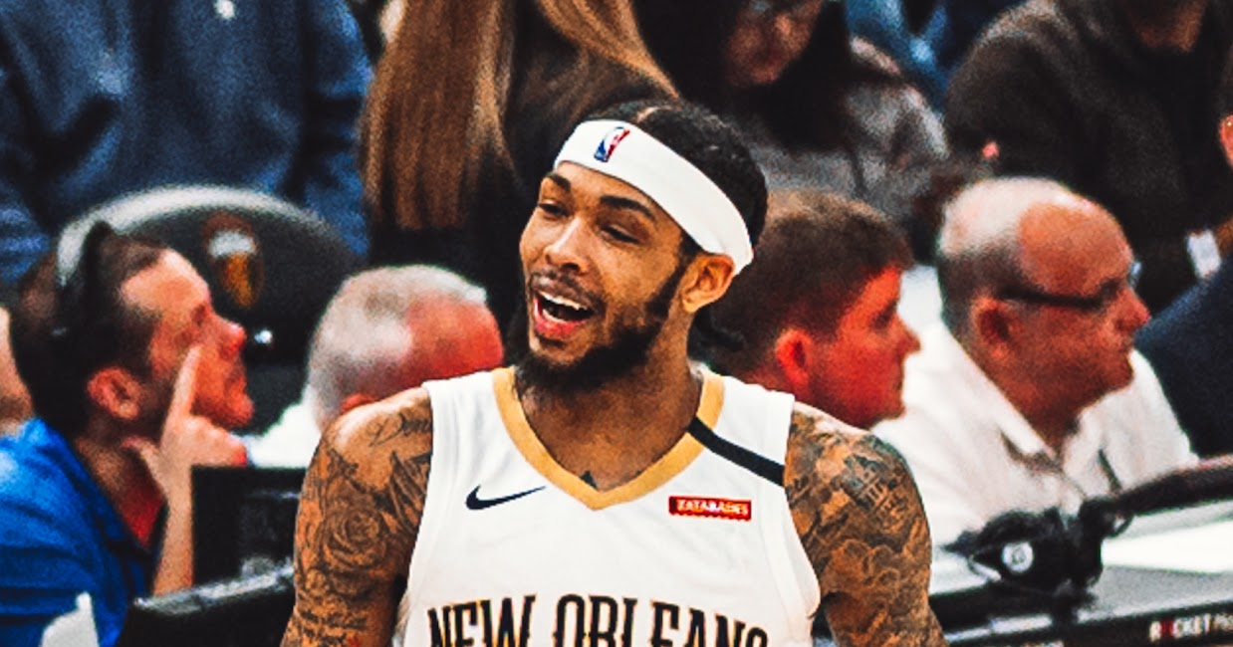
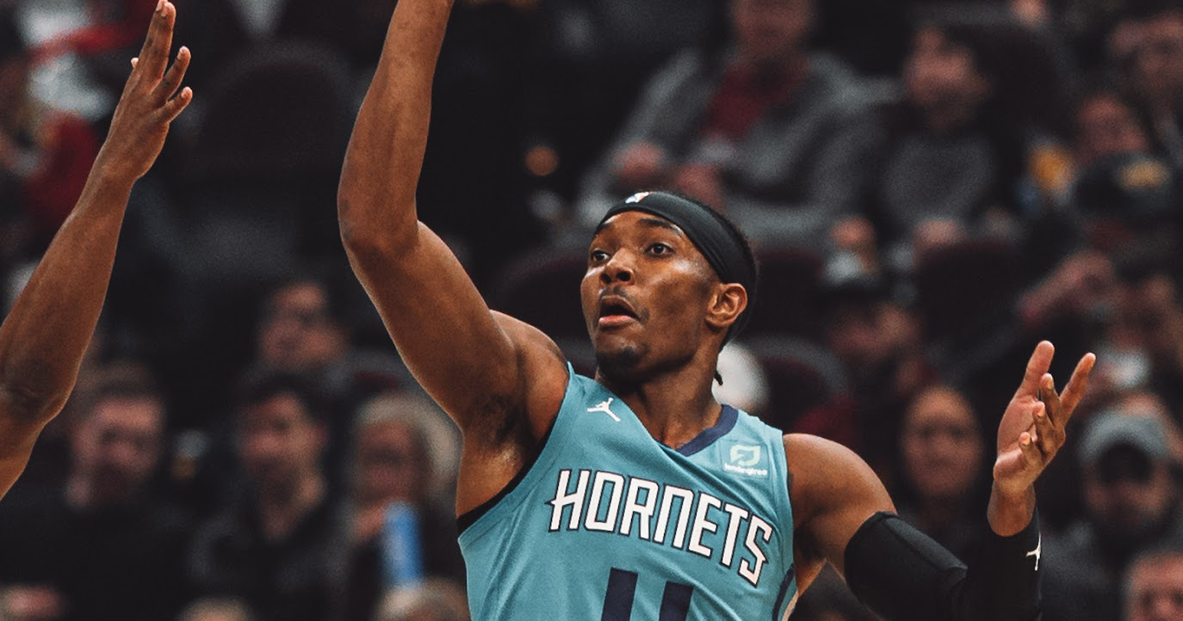
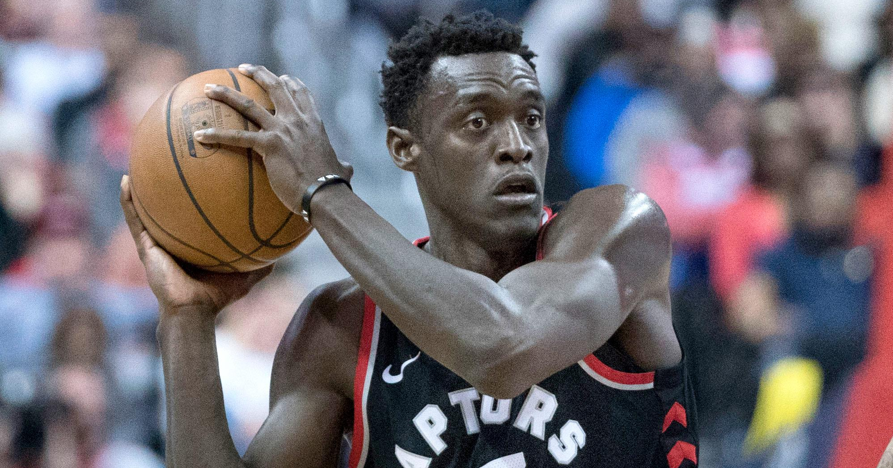
Introduction: Case Study
Brandon Ingram was traded from the Lakers, which has one of the most popular fan bases so more eyes were naturally on him. He won the award in 2020 despite not having the same level of improvement or team success.
Devonte Graham had one of the most memorable seasons in 2020, improving in all statistics (most notably 4 ppg to 18 ppg). However, he did not win the award because he was only in his 2nd year (voters say improvement should be expected of 2nd years).
Pascal Siakam won the award in 2019, with stats very much similar to that of Graham (7.3 ppg to 16.9 ppg). However, the year prior, the Raptors won the Championship and their best player left, meaning more eyes were naturally on him.
Notes:
Ryan

Slide 4
Motive
For our project, we will attempt to create a machine learning model that:
accurately predicts the candidates (for current, fan purposes)
establishes a concrete criteria without giving too much weight to the narrative (for future voters)
ranks players based off of this criteria (for front office purposes)
Notes:
Ryan

Slide 5
Data Collection

Slide 6
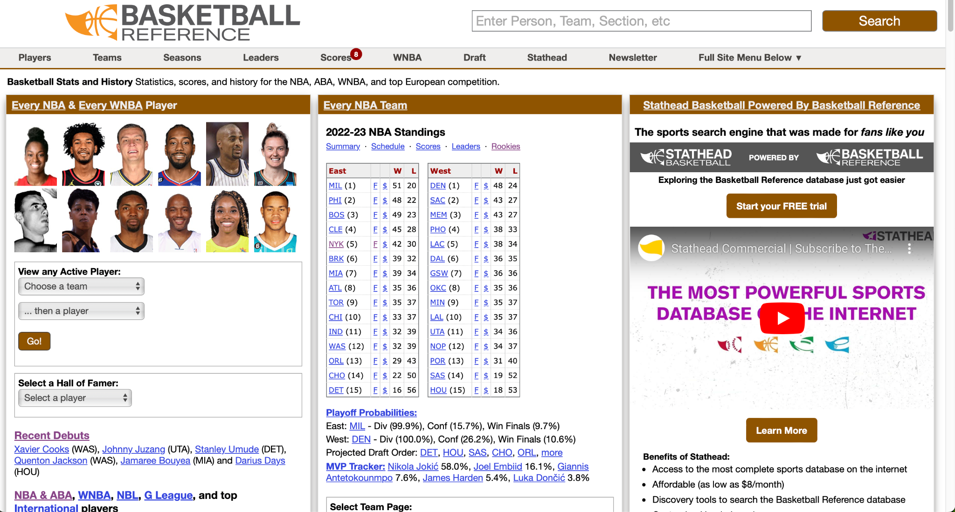
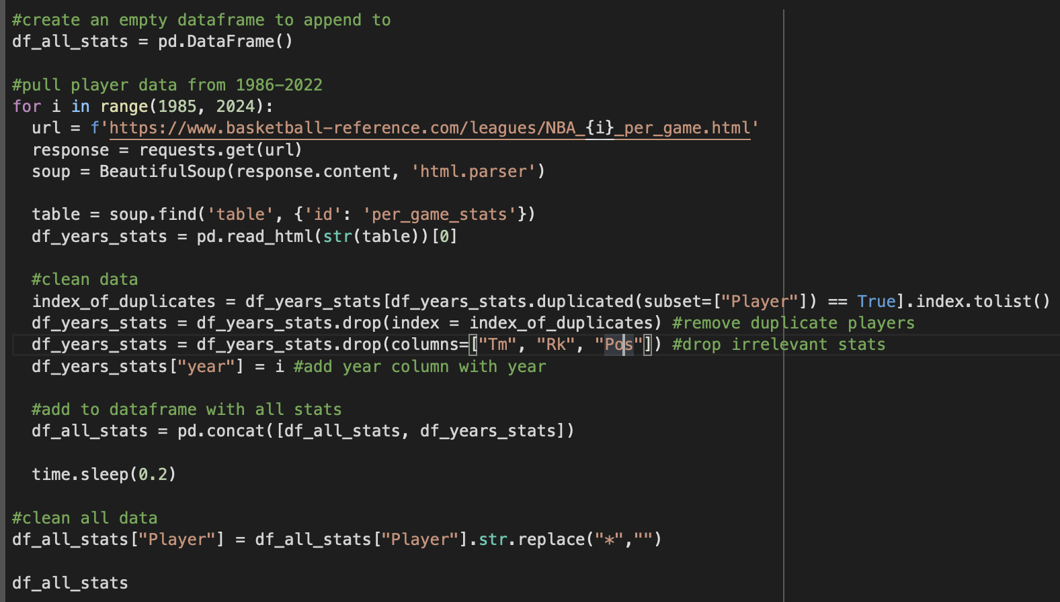
Data Collection
Retrieved all data through web scraping basketball-reference.com.
The site had all statistics of NBA players from our desired year range of 1985 - 2022
The site also had voting results for MIP from 1985-2022
Notes:
Neil

Slide 7
Data Collection
Notes:
Neil

Slide 8
Data Cleaning and Manipulation

Slide 9
Data Cleaning and Manipulation
There were many instances where a Players stat was listed as NaN. For example, some players never shot a three pointer the entire season. We filled those in with 0.
For our project, we decided the best way to measure improvement was the change in each statistic from the previous year (difference).
We had to create a new dataframe that had improvement rather than current statistics.
Create a dataframe where all players and their previous years were next to each other
Remove players that did not have a previous year (rookies, etc.)
Subtract those two rows from each other
Notes:
Ryan

Slide 10
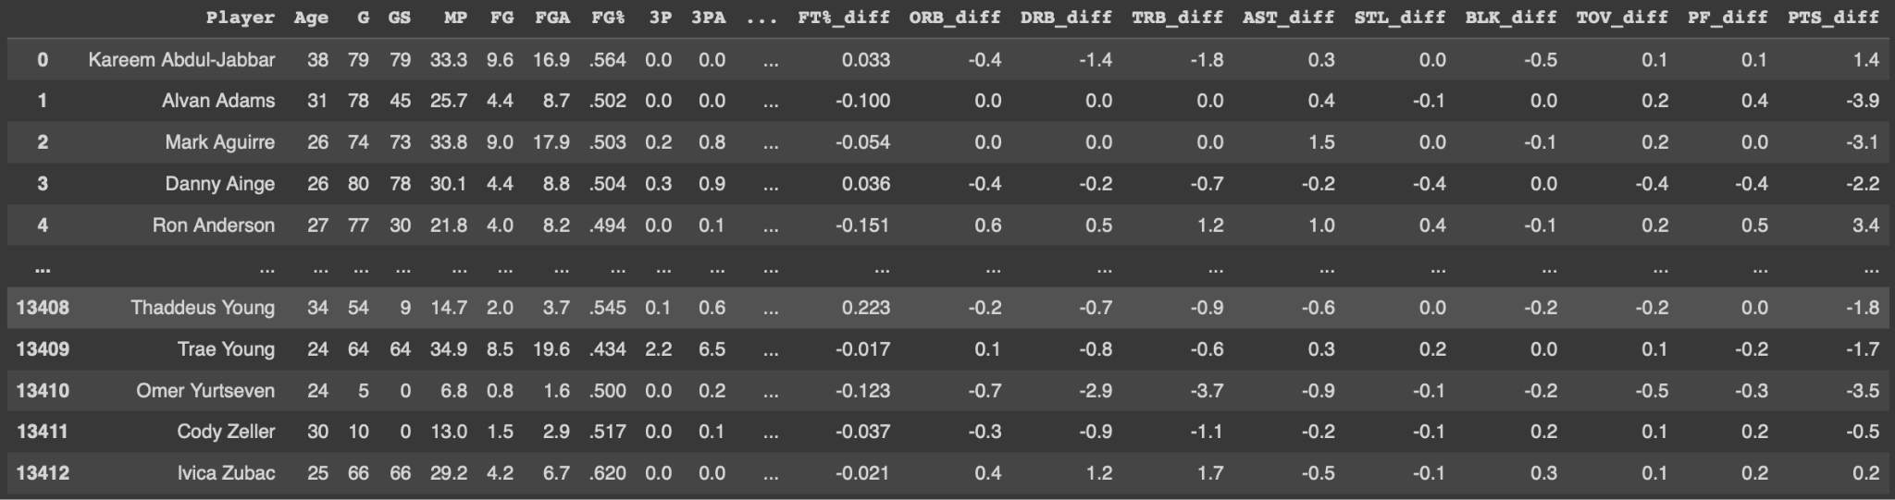
Data Cleaning and Manipulation
Notes:
Ryan

Slide 11
Data Exploration

Slide 12
Data Exploration
Motive: To better understand the significance of certain statistics and also see if we can possibly incorporate content filtering to make machine learning more efficient and accurate.
Notes:
Neil

Slide 13
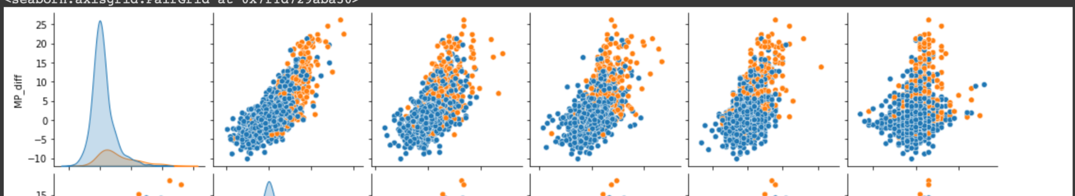
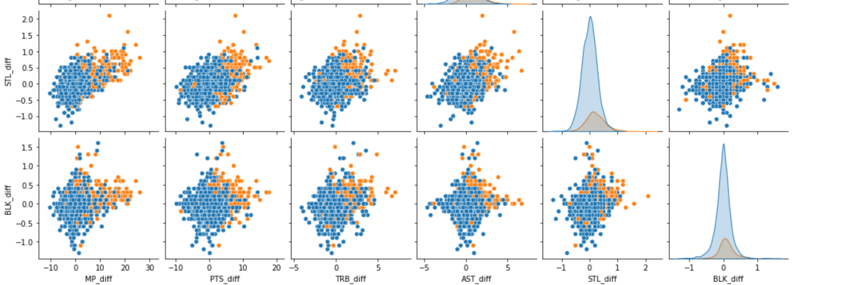
Identifying Relevant Statistics
Conclusion: Minutes Played improvement seems to be a strong indicator of most improved candidate. Blocks and steals improvement is less significant.
Notes:
Ryan

Slide 14
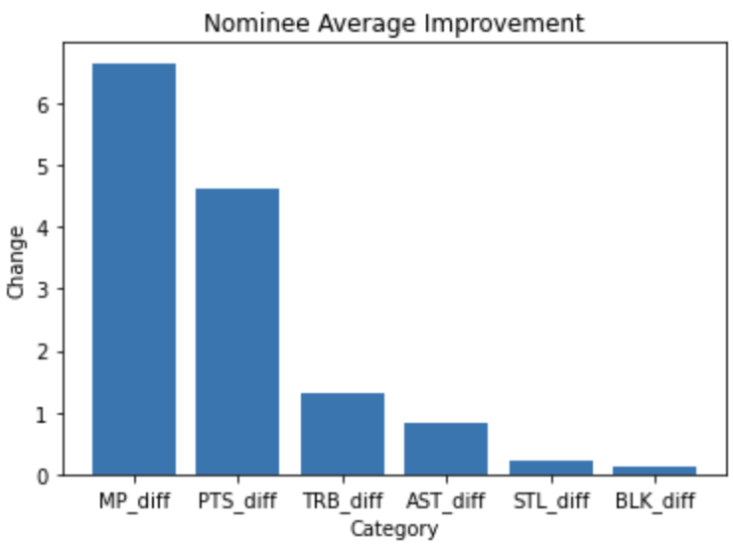
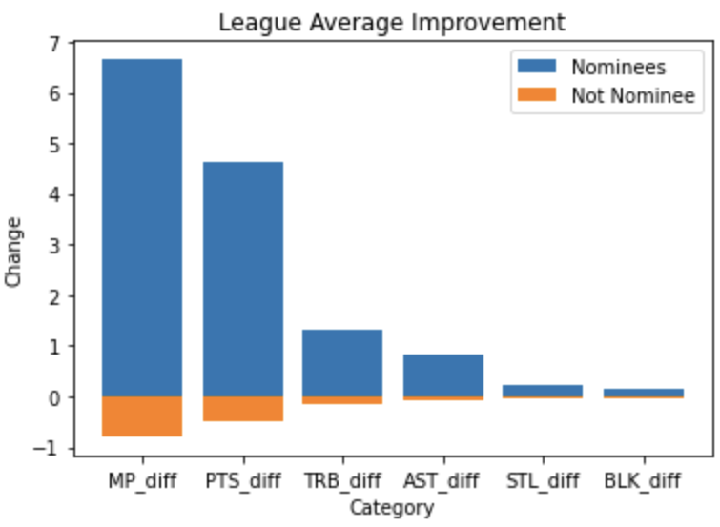
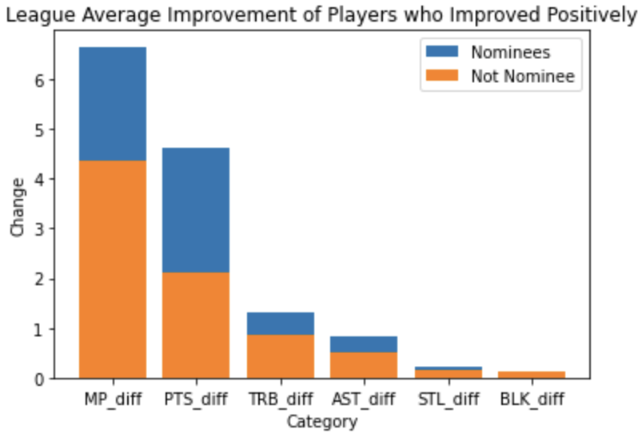
Contextualizing Statistics
Conclusion: Minutes Played and Average Points seem to be statistics that we must include in our machine learning model. Blocks and steals most likely won’t be useful
Notes:
Neil

Slide 15
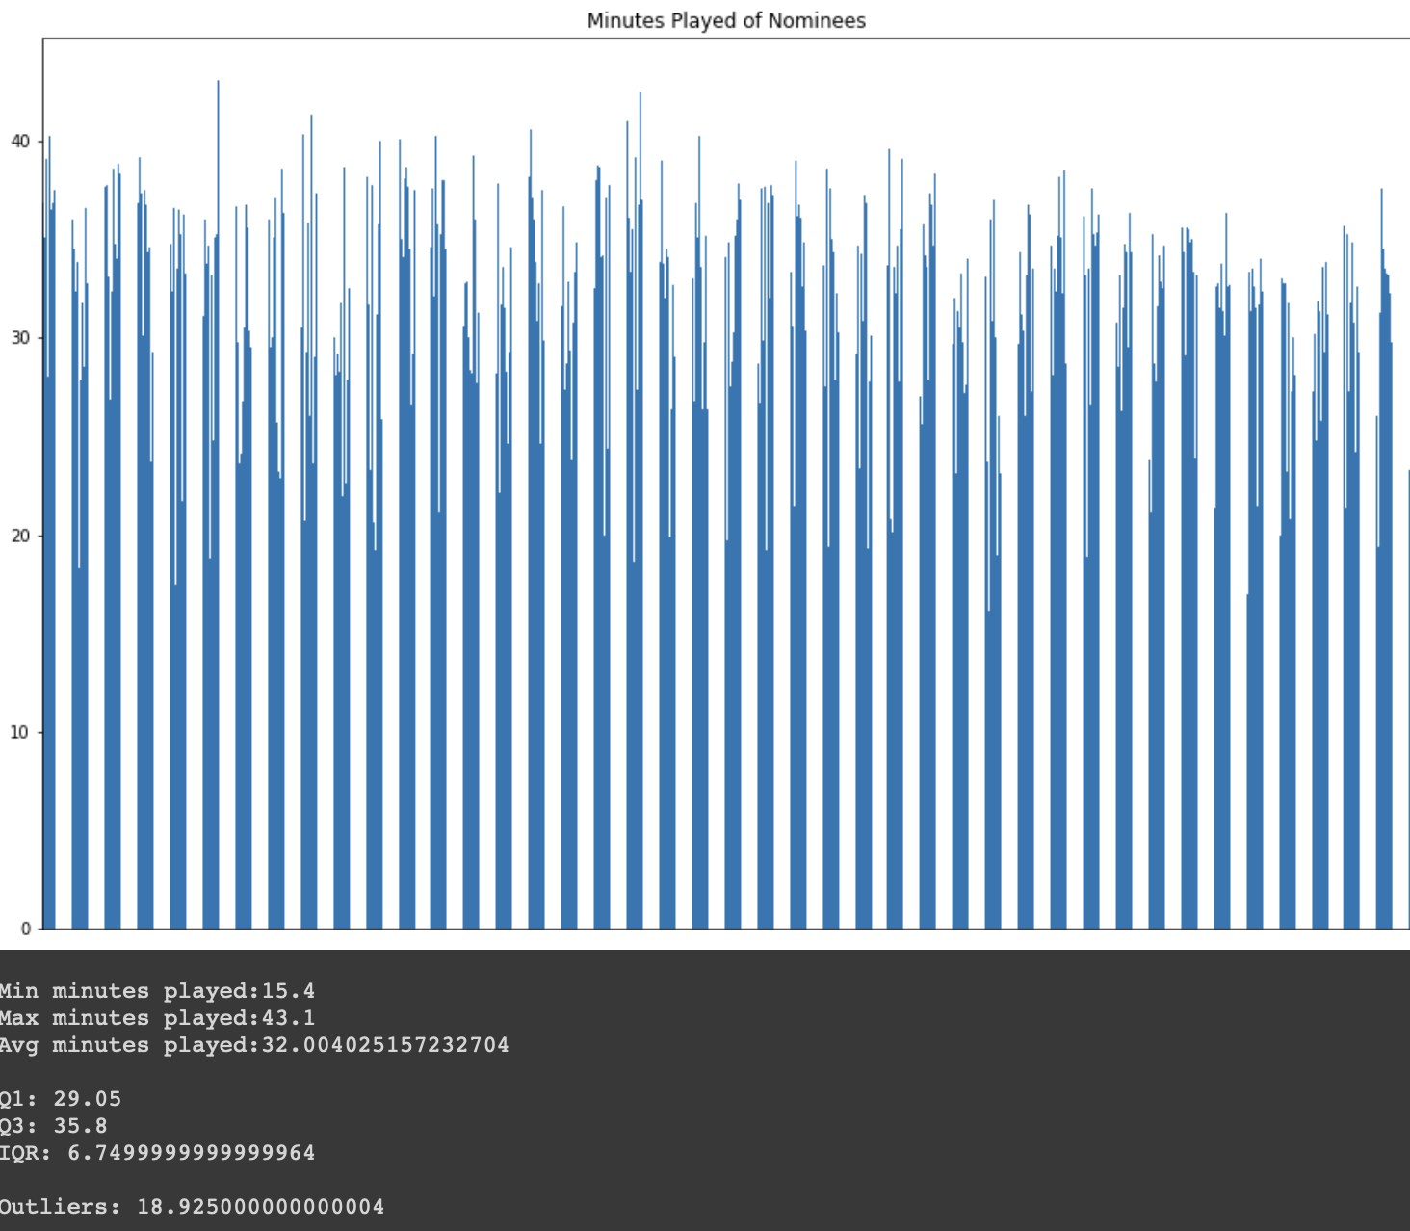
Threshold Identification
For each statistic, we created a bar chart that helped us better visualize the how most of the candidates were performing.
From there, we calculated the IQR and outliers to determine whether a threshold needed to be established.
For statistics such as minutes played had such a wide range, we felt like it would be effective to set a threshold at Q1 to establish a “criteria”. After all, a player that goes from 15 minutes to 30 minutes should have heavier consideration than 2 minutes to 17 minutes.
Notes:
Ryan

Slide 16
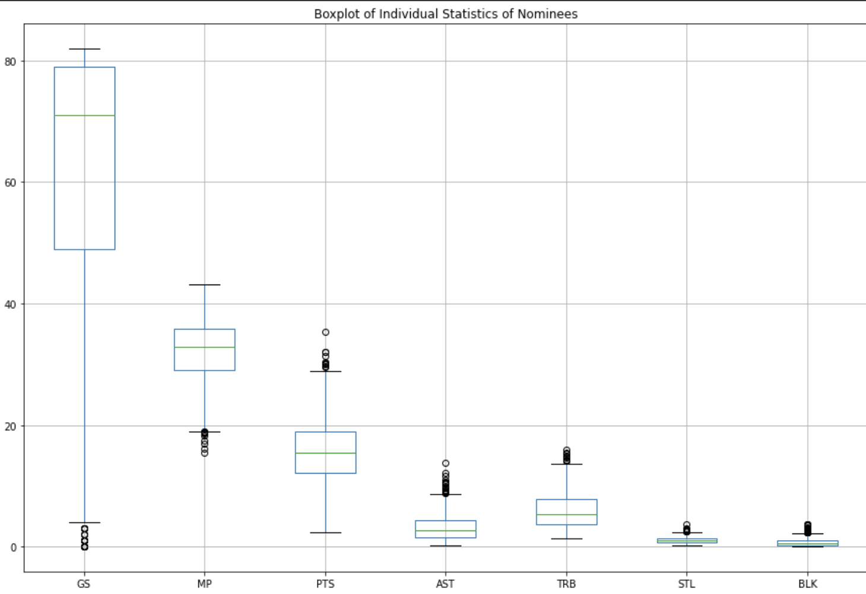
Threshold Identification Cont.
We can see that some statistics have a wide range due to the nature of the statistic. For those statistics, we feel like it would be fair to establish a minimum threshold at Q1.
49 Games Started
29.1 minutes per game
12.1 points per game
1.5 assists per game
3.6 total rebounds per game
Notes:
Ryan

Slide 17
Machine Learning

Slide 18
Preparing for Machine Learning
Goal: How well can we predict MIP player candidates and ranking (predict share of votes)?
Potential Features: GS, MP_diff, MP, PTS_diff, PTS, AST_diff, TRB_diff, TRB, STL_diff, BLK_diff
Predicting quantitative value: Regression
Reorganized data so that the Data Frame contains share of votes for players who did get votes in the past.
Training data will be from 1985- 2017
Reserve 2018-2022 for testing
Notes:
Neil

Slide 19
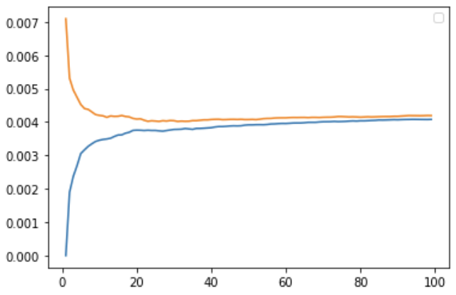
K-Nearest Neighbors Regression
Best K value: 31
Best set of features: GS, MP_diff, PTS_diff, PTS, AST_diff
StandardScaler() and Euclidean
Validation MSE: 0.004019
Notes:
Neil

Slide 20
Linear Regression
Best Set of features: GS, MP_diff, PTS_diff, PTS, AST_diff, AST, TRB_diff
StandardScaler()
Validation: 0.004471
Notes:
Neil

Slide 21
Ensemble Models
Ensemble Linear and KNeighbors models
Voting MSE: 0.004125
Stacking MSE: 0.003967
Notes:
Ryan

Slide 22
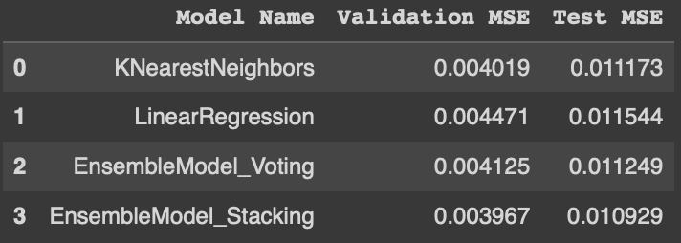
Making Predictions
Best Validation: Stacking
Best Test: Stacking
Notes:
Ryan

Slide 23
So Why Our Model?

Slide 24
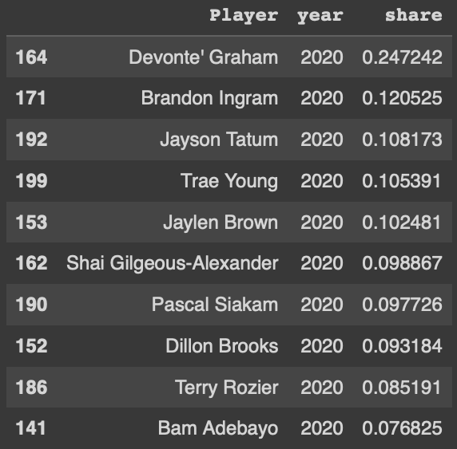
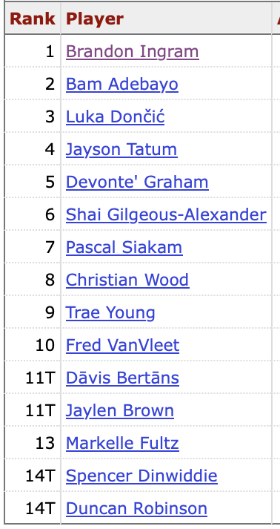
Benefits of Our Model: Return to Case Study
8/10 of the player predicting by our model were in the top 15 of nba voters.
The only players not in the voting were Dillon Brooks and Terry Rozier
Terry Rozier is now averaging nearly 22ppg with the Hornets.
Dillon Brooks is a quality starter for the grizzlies on an extremely team friendly deal of 12 million per year
Devonte Graham wins the award over Brandon Ingram. Graham missing out on the award was considered one of the greatest robberies of the MIP award.
Notes:
Ryan

Slide 25
Just for Fun…

Slide 26
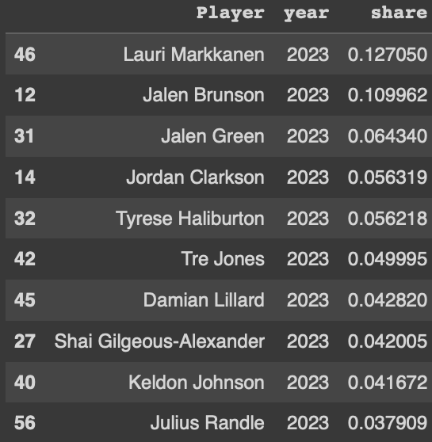
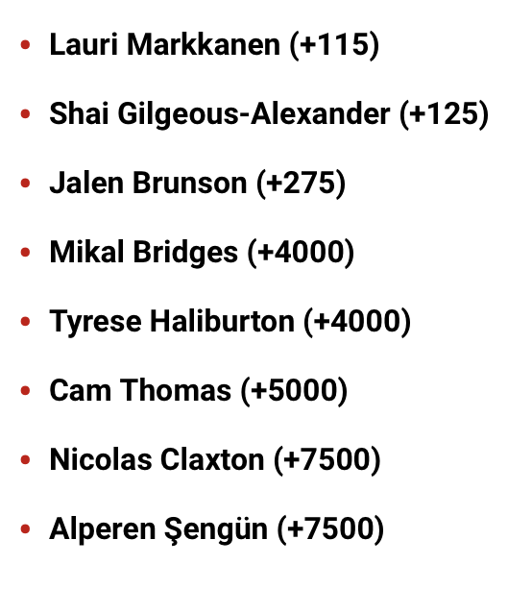
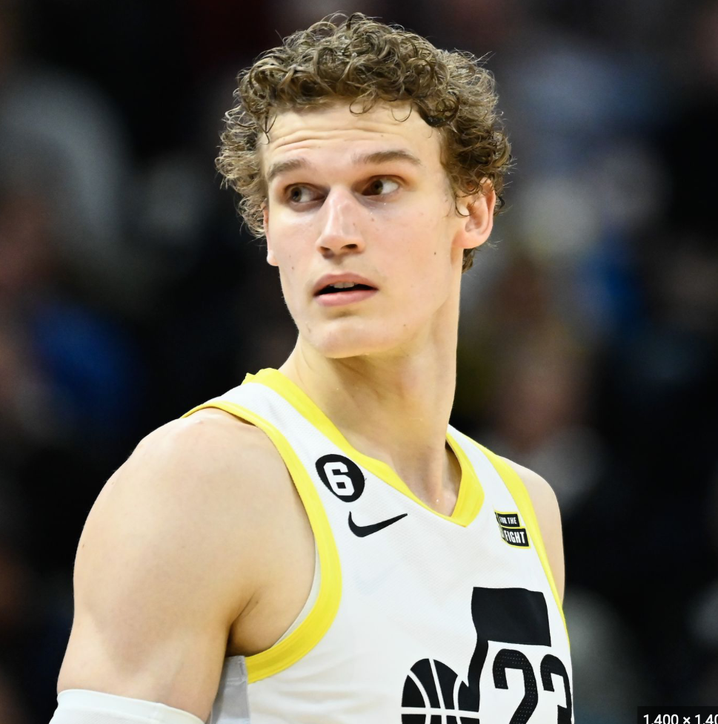
Who will win the award this year?
Our believes that Markkanen will the award among him, Brunson, and Green
Sportsbooks have him also winning among him, Gilgeous-Alexander, and Brunson
Our Model considers the narrative but also puts more weight on true improvement.
Notes:
Ryan

Slide 27
Questions?

